Slide 1

Applied Internet of Things(CSE 2198) Project Presentation on Real-Time Drowsiness and Yawn Detection with Buzzer Alerts Enabled by Dlib on Raspberry Pi.
Presented by
Section:-2241037
Mr.Kalia Sahu-2241019195
Mr. Ashmit Srivastava-2241019555
Mr. Abhay Kumar Singh-2241019452
Mr. Ch.Vedankar Sastry-2241019325
Supervisor
Dr. Biswaranjan Swain
Department of Computer Science and Engineering (IOT)
Institute of Technical Education & Research (ITER)
Siksha ‘O’ Anusandhan Deemed to be University, Bhubaneswar
May, 2024

Slide 2
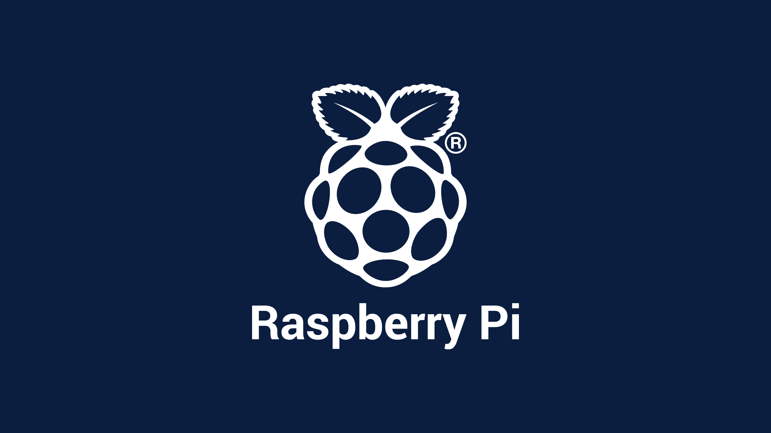
Contents
Introduction
Literature Survey
Design Scheme
Results, Analysis and Evaluation
Socio-economic Issues Associated With The Project
Engineering Tools And Standards
Conclusion

Slide 3
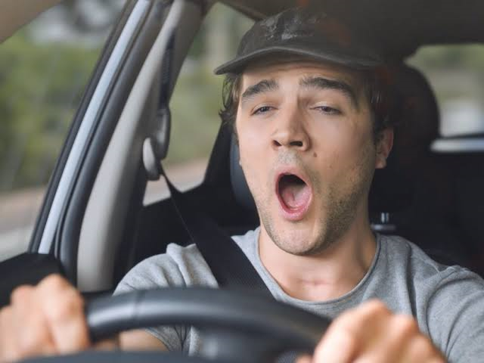
Introduction
Brief overview of the project:-
The system will utilize computer vision techniques to analyze facial landmarks, particularly focusing on eye and mouth regions, to detect signs of drowsiness (e.g., eye closure, drooping eyelids) and yawning.
Importance of detecting drowsiness and yawning in real-time:-
Safety Enhancement:
Health Monitoring:
Preventative Healthcare:

Slide 4
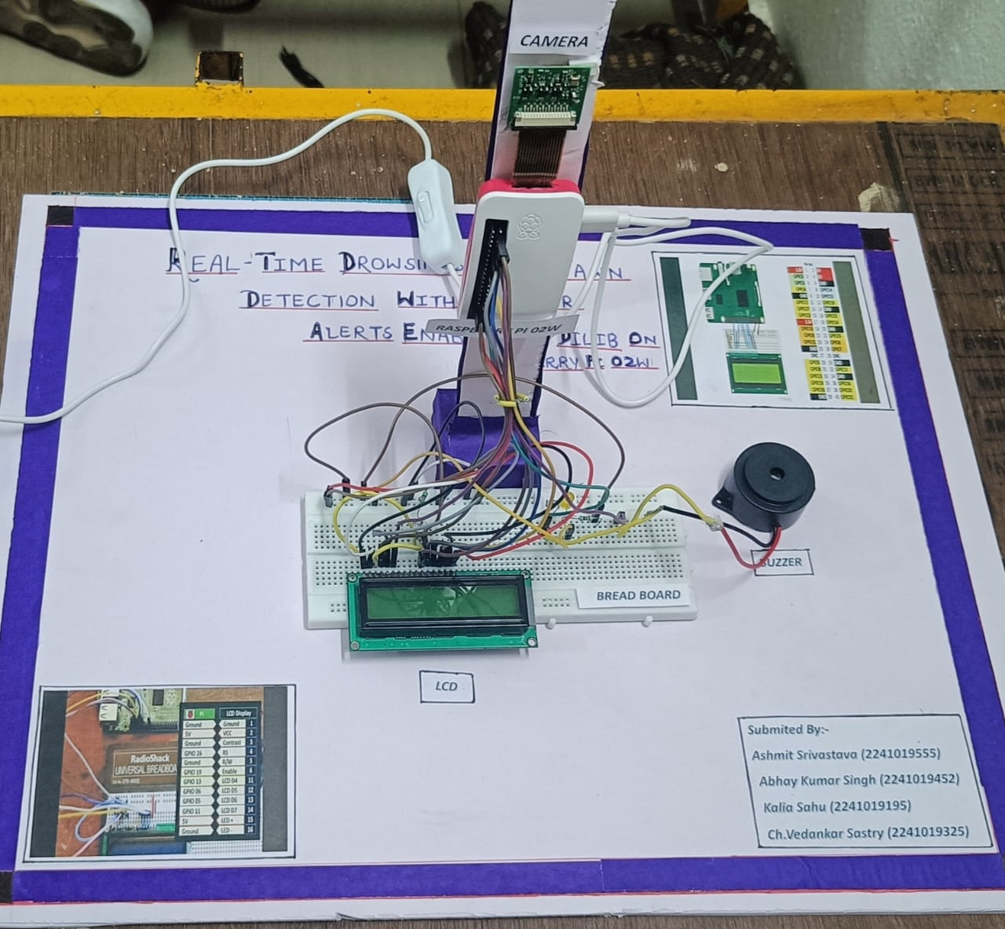
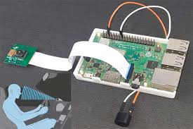
Literature Survey
Real-time Eye Blink Detection Using Facial Landmarks
Yawning Detection in Real-time Video Using Deep Learning
Eye Aspect Ratio (EAR) Technique:
Mouth Aspect Ratio (MAR) Technique:
Physical Prototype

Slide 5
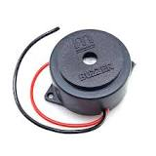
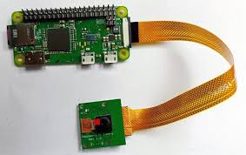
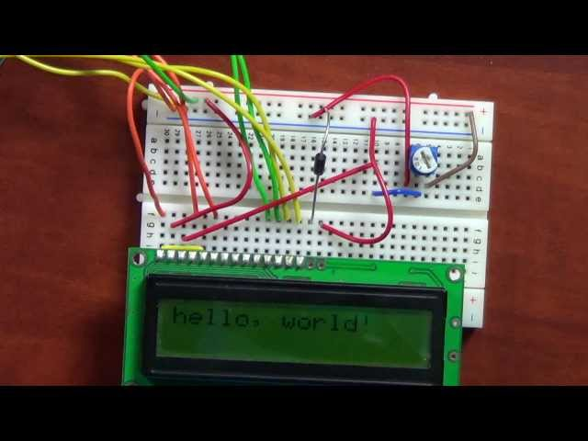
Design Scheme:
Hardware Setup
Raspberry Pi 02w
5MP Camera Module
Buzzer
LCD
Jumper wires
Resistors (as needed)
Connect Power Supply
Software Setup
dlib
cv2
numpy
face_utils
Buzzer
Raspberry pi 02w with Camera
Breadboard with LCD

Slide 6
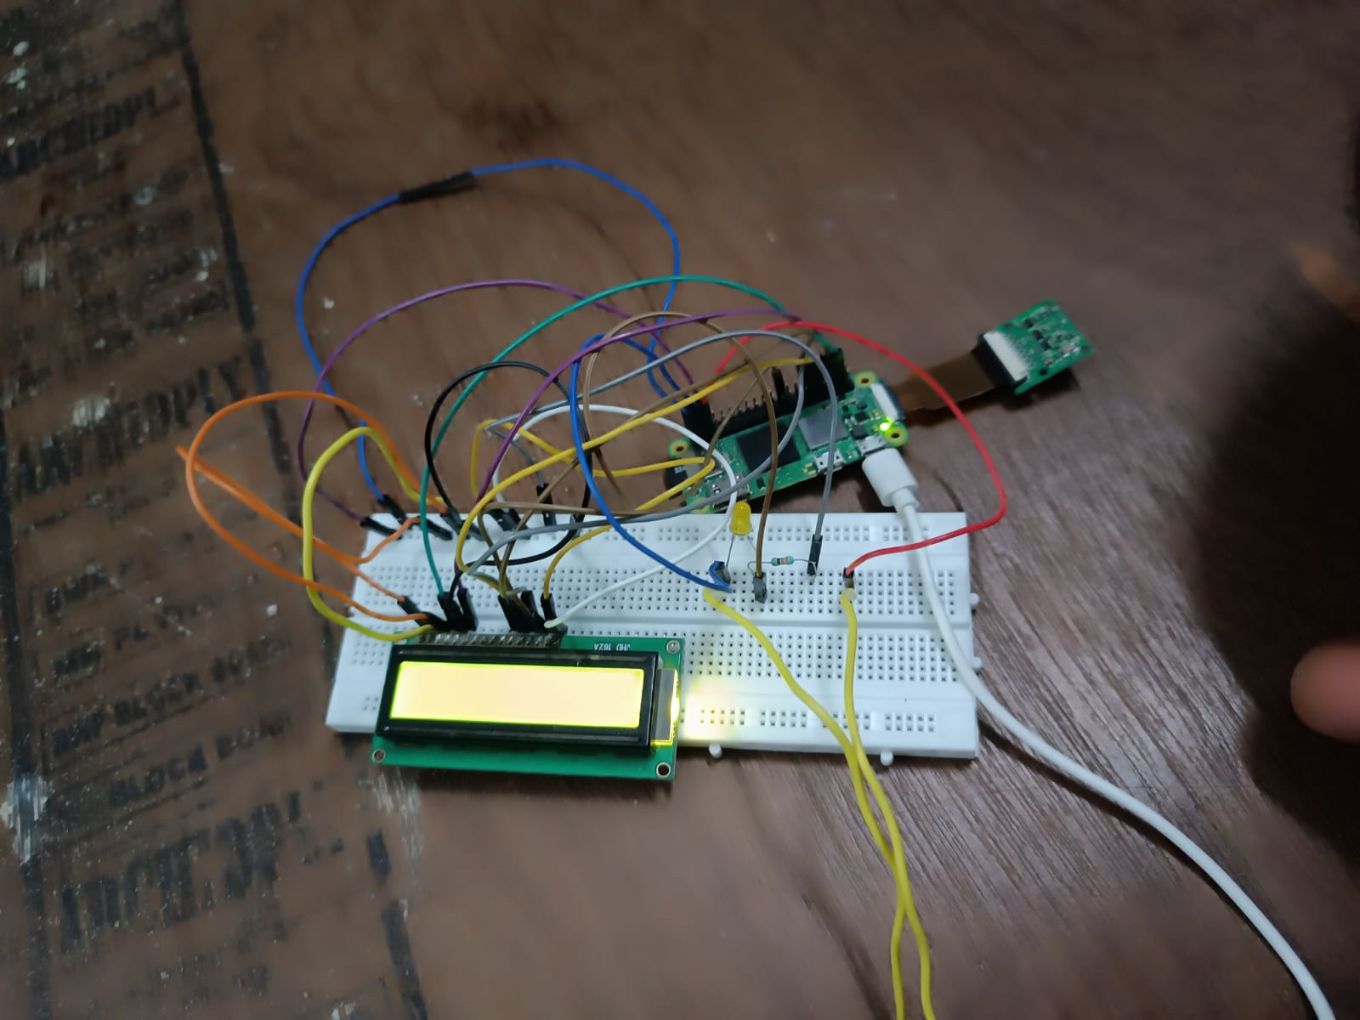
Hardware
Hardware Components:
Raspberry Pi 02W: The main computing platform responsible for running the detection algorithms and processing video input.
Camera Module: A compatible camera module (e.g., Raspberry Pi Camera Module) for capturing real-time video footage of the user's face.

Slide 7
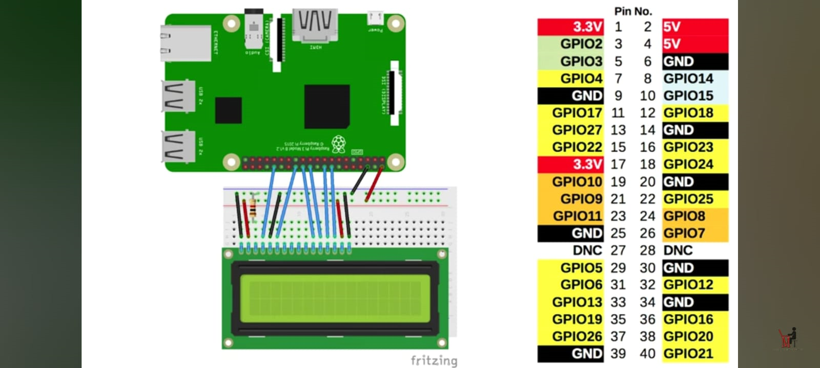
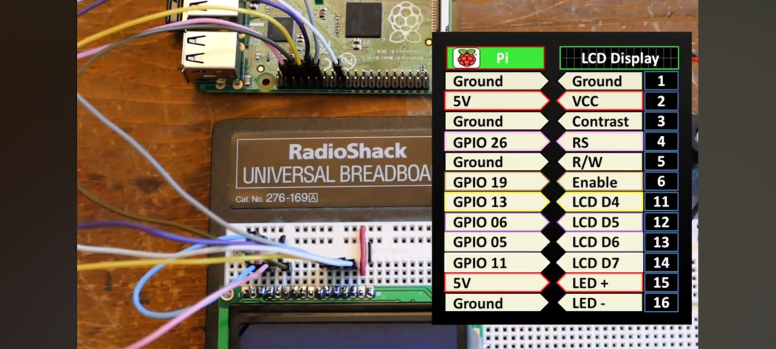
Connection
fig.1-Circuit Diagram
fig.2-Connection for LCD

Slide 8
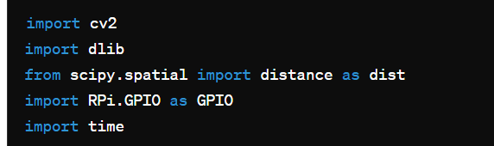
Software
Software Components:
Operating System: Install Raspbian or any other compatible operating system on the Raspberry Pi.
Python Programming: Utilize Python as the primary programming language for implementing the detection algorithms and controlling the system.
Dlib Package: Install the Dlib package, which provides robust facial detection and landmarking capabilities.
OpenCV: Use OpenCV for image processing tasks, such as capturing video frames and displaying output.
Other Python Libraries: Depending on specific requirements, you may need additional Python libraries for tasks such as machine learning (e.g., scikit-learn), numerical computations (e.g., NumPy), or data visualization (e.g., Matplotlib).

Slide 9
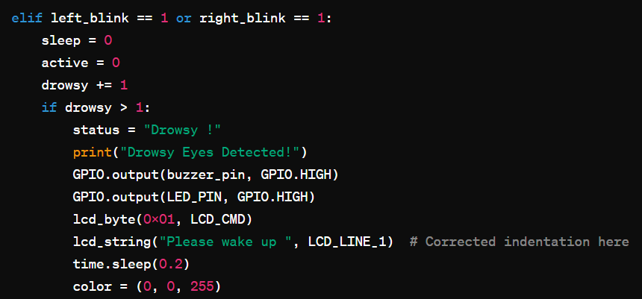
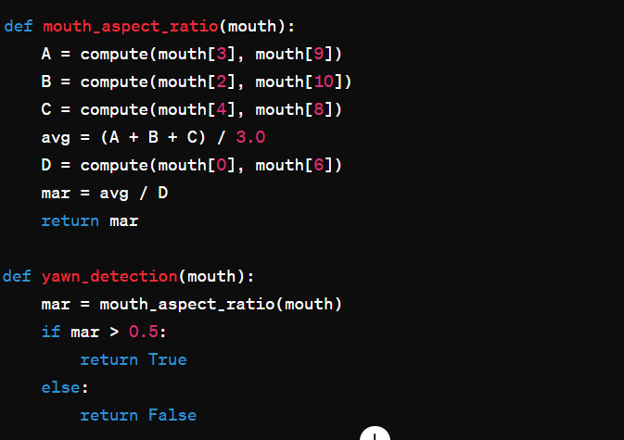
Code For Eye and yawn Detection

Slide 10
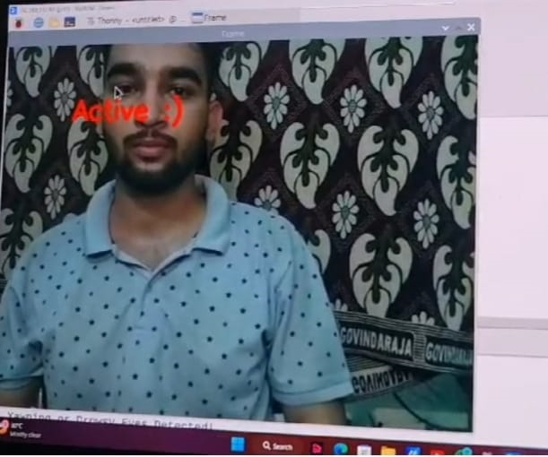
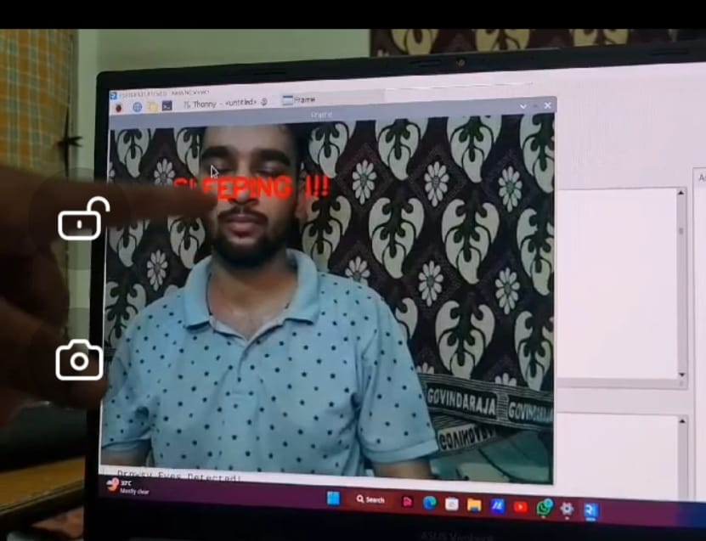
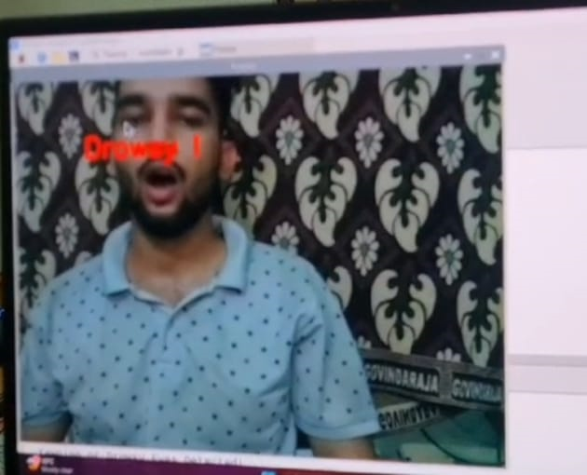
Results, Analysis and Evaluation
Results,Analysis & Evaluation:-
Effectiveness of Eye Aspect Ratio (EAR) Threshold:
Effectiveness of Mouth Aspect Ratio (MAR) Threshold:
Impact of Environmental Factors:
Advantages of the Developed System:

Slide 11
Socio-economic Issues Associated With The Project
Accessibility and Affordability:-Ensuring that the system remains accessible and affordable to a wide range of users is crucial. This includes consideration of the cost of the hardware components (Raspberry Pi, camera module) and any additional peripherals required for deployment.
Privacy and Data Security:-Collecting and processing facial data for drowsiness and yawn detection raise concerns about privacy and data security.
Health and Well-being:-While the primary goal of the system is to enhance safety by detecting drowsiness and preventing accidents, it's important to consider the broader implications for users' health and well-being.
Education and Awareness:- Providing clear information about how the technology works and its potential benefits can help mitigate concerns and promote informed decision-making.

Slide 12
Conclusion
In conclusion, the development of a real-time drowsiness and yawn detection system using the Dlib package on a Raspberry Pi 02W represents a significant advancement in safety technology with broad implications for various domains.
The implementation of robust algorithms for facial landmark detection, eye aspect ratio calculation, and mouth aspect ratio analysis has enabled the system to effectively monitor alertness levels and mitigate the risk of accidents or errors caused by fatigue.
Looking ahead, there are numerous opportunities for further research and development, including the integration of additional features or sensors, optimization of algorithms for improved accuracy and efficiency, and deployment in real-world settings across various industries.
In summary, the development of this real-time drowsiness and yawn detection system underscores the transformative impact of technology on addressing real-world challenges and underscores our commitment to innovation, safety, and societal progress.

Slide 13
References
.https://www.youtube.com/watch?v=RDuLqCT5RxY&list=PLmxueiA72TthW5mvdZMD4
https://youtu.be/YDllsKi6mo4?si=hCnsxOTSb9mRlxvl
3. https://github.com/Arijit1080/Drowsiness-and-Yawn-Detection-with-voice-alert_x0002_using-Dlib

Slide 14


Slide 15


